Slide 1

Micro Processors & Interfacing
16CS307
Unit- 5 :
8051 - Microcontroller Hardware & Interfacing :
Lec-1
Mr. M Krishna Chennakesava Rao,
Asst. Professor, Dept. of ECE,
VFSTR University

Slide 2
Micro Processor & Interfacing
Syllabus Overview
UNIT 1 - Introduction to 8086microprocessor
UNIT 2 - Hardware features of 8086
UNIT 3 - Advanced Processors
UNIT 4- Introduction to 8051Microcontroller
UNIT 5 -8051 Microcontroller Hardware & Interfacing:

Slide 3
Unit-5 Syllabus Overview
Parallel Ports in 8051
External Memory interfacing with 8051
8051 Timers
8051 Serial ports
8051 Interrupts
8051 Interfacing
LCD Interfacing
Keyboard Interfacing
DAC Interfacing
ADC Interfacing
Stepper Motor Interfacing
External Memory interfacing

Slide 4
8051 Foot Print
5.1. Parallel Ports in 8051
P1.0
1
40
Vcc
P1.1
2
39
P0.0(AD0)
P1.2
3
38
P0.1(AD1)
P1.3
4
8051
(8031)
(8751)
(8951)
37
P0.2(AD2)
P1.4
5
36
P0.3(AD3)
P1.5
6
35
P0.4(AD4)
P1.6
7
34
P0.5(AD5)
P1.7
8
33
P0.6(AD6)
RST
9
32
P0.7(AD7)
(RXD)P3.0
10
31
EA/VPP
(TXD)P3.1
11
30
ALE/PROG
S I T WR ite
(INT0)P3.2
12
29
PSEN
(INT1)P3.3
13
28
P2.7(A15)
(T0)P3.4
14
27
P2.6(A14)
(T1)P3.5
15
26
P2.5(A13)
(WR)P3.6
16
25
P2.4(A12)
(RD)P3.7
17
24
P2.3(A11)
XTAL2
18
23
P2.2(A10)
XTAL1
19
22
P2.1(A9)
GND
20
21
P2.0(A8)

Slide 5
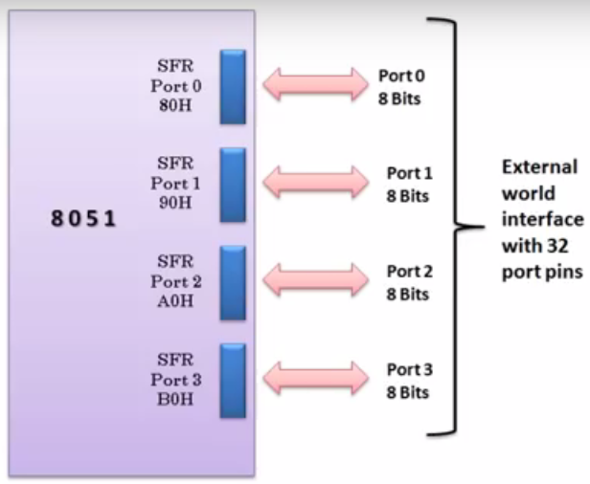
5.1. Parallel Ports in 8051

Slide 6
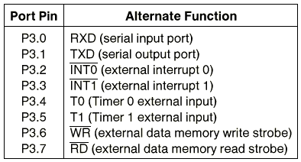
Port 3 Alternate Functions
5.1. Parallel Ports in 8051 cont’d…

Slide 7
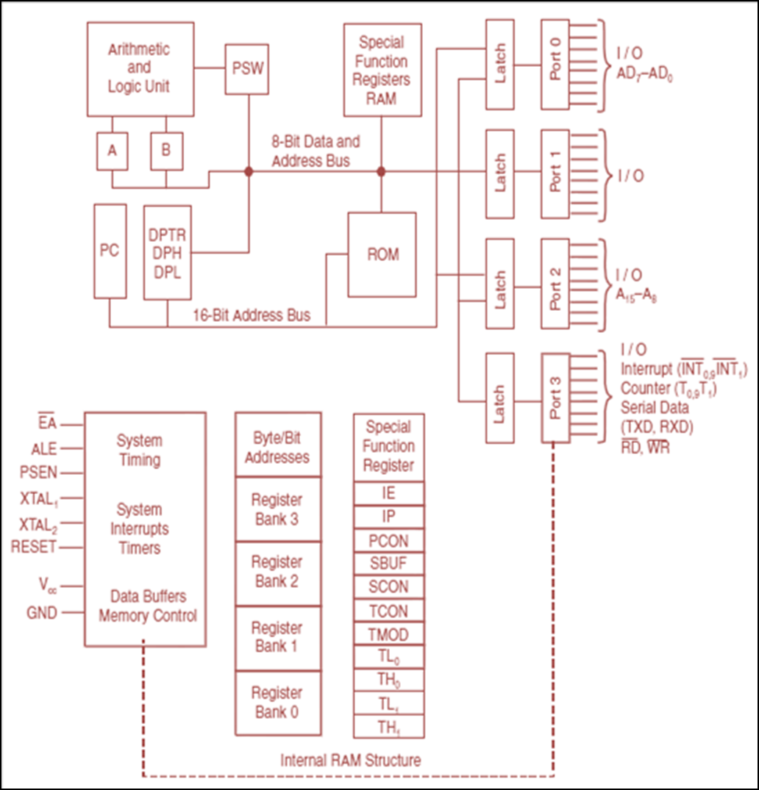
8051- Architecture

Slide 8
Hardware Structure of Port 1 I/O Pin
5.1. Parallel Ports in 8051 cont’d…
Read latch
Vcc
TB2
Load(L1)
Internal CPU bus
D Q
Clk Q
P1.X pin
P1.X
Write to latch
M1
TB1 :
Tri-state Buffer
Read pin

Slide 9
Hardware Structure of I/O Pin
5.1. Parallel Ports in 8051 cont’d…
Each pin of I/O ports
Internally connected to CPU bus
A D latch store the value of this pin
Write to latch＝1：write data into the D latch
2 Tri-state Buffer：
TB1: controlled by “Read pin”
Read pin＝1： read the data present at the pin
TB2: controlled by “Read latch”
Read latch＝1：read value from internal latch
A transistor M1 gate
Gate=0: open
Gate=1: close

Slide 10
Writing “1” to Output Pin P1.X
5.1. Parallel Ports in 8051 cont’d…
Read latch
Vcc
TB2
Load(L1)
2. output pin is Vcc
1. write a 1 to the pin
1
P1.X pin
Internal CPU bus
D Q
Clk Q
P1.X
0
output 1
Write to latch
M1
TB1
Read pin

Slide 11
Writing “0” to Output Pin P1.X
5.1. Parallel Ports in 8051 cont’d…
Read latch
Vcc
TB2
Load(L1)
2. output pin is ground
1. write a 0 to the pin
0
P1.X pin
Internal CPU bus
D Q
Clk Q
P1.X
1
output 0
Write to latch
M1
TB1
Read pin

Slide 12
Reading “High” at Input Pin
5.1. Parallel Ports in 8051 cont’d…
Read latch
Vcc
2. MOV A,P1
external pin=High
TB2
write a 1 to the pin MOV P1,#0FFH
Load(L1)
1
1
P1.X pin
Internal CPU bus
D Q
Clk Q
P1.X
0
M1
Write to latch
TB1
Read pin
3. Read pin=1 Read latch=1 Write to latch=1

Slide 13
Reading “Low” at Input Pin
5.1. Parallel Ports in 8051 cont’d…
Read latch
Vcc
2. MOV A,P1
external pin=Low
TB2
write a 1 to the pin
MOV P1,#0FFH
Load(L1)
1
0
P1.X pin
Internal CPU bus
D Q
Clk Q
P1.X
0
M1
Write to latch
TB1
Read pin
3. Read pin=0 Read latch=1 Write to latch=1
8051 IC

Slide 14
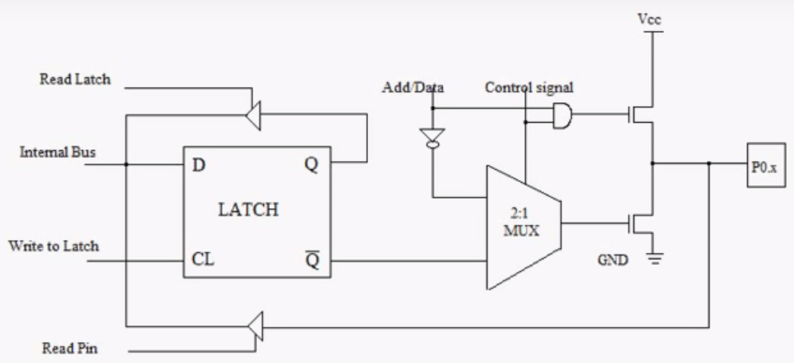
Port 0 Configuration
5.1. Parallel Ports in 8051 cont’d…
ALE
1
0

Slide 15
Port 0 with external Pull-Up Resistors
5.1. Parallel Ports in 8051 cont’d…
Vcc
10 K
Port 0
P0.0
DS5000
8751
8951
P0.1
P0.2
P0.3
P0.4
P0.5
P0.6
P0.7

Slide 16
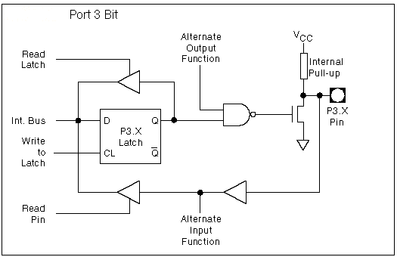
8051 Port 3 Bit Latches and I/O Buffers
5.1. Parallel Ports in 8051 cont’d…

